Slide 1
High-Fidelity Generative Image Compression(NeurIPS 2020)
108753208 葉冠宏

Slide 2
Introduction
1. We extensively study how to combine Generative Adversarial Networks and learned compression to obtain a state-of-the-art generative lossy compression system. In particular, we investigate normalization layers, generator and discriminator architectures, training strategies, as well as perceptual losses.
2. We bridge the gap between rate-distortion perception theory and practice by evaluating our approach both quantitatively with various perceptual metrics, and with a user study.

Slide 3
Related work
1. [47] George Toderici, Damien Vincent, Nick Johnston, Sung Jin Hwang, David Minnen, Joel Shor, and Michele Covell. Full resolution image compression with recurrent neural networks. arXiv preprint arXiv:1608.05148, 2016.
-It uses RNN
2. [39] Oren Rippel and Lubomir Bourdev. Real-time adaptive image compression. In Proceedings of the 34th International Conference on Machine Learning, volume 70 of Proceedings of Machine Learning Research,pages 2922–2930, International Convention Centre, Sydney, Australia, 06–11 Aug 2017. PMLR.
-It uses an adversarial loss as a component in their full-resolution compression system, but they do not systematically ablate and asses the benefits of this loss on the quality of their reconstructions.

Slide 4
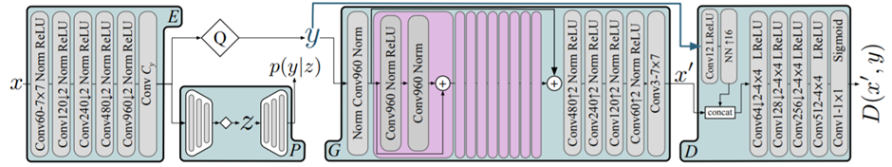
Method
parameter: Adam for 2 000 000 steps

Slide 5
Conditional GANs
1. Conditional GANs are a way to learn a generative model of a conditional distribution p(X|S),
where each datapoint x is associated with additional information s (e.g., class labels or a semantic map) and x, s are related through an unknown joint distribution pX,S.
2. we train two rivaling networks: a generator G that is conditioned on s to map samples y from a fixed known distribution Py to Px|s
and a discriminator D that maps an input (x, s) to the probability that it is a sample from Px|s rather than from the output of G.
3. The goal is for G to “fool” D into believing its samples are real, i.e., from Px|s. Fixing s, we can optimize the “non-saturating” loss.

Slide 6
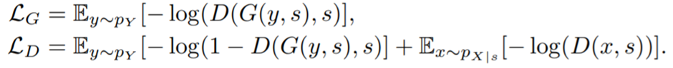
non-saturating loss.
D(x)表示D網路判斷真實圖片是否真實的機率，對於D來說，這個值越接近1越好。
D(G(z))是D網路判斷G生成的圖片的是否真實的機率，對於D來說，這個值越接近0越好，對於G來說，這個值越接近1越好。

Slide 7
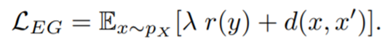
Autoencoder(E(encode)->G(decode,generator))
1.To encode an image x (lossy compression), we obtain a quantized latent y = E(x).
2.To decode, we use G to obtain the lossy reconstruction x’ = G(y).
3.The compression incurs a distortion d(x, x’), e.g., d = MSE
4.Storing y is achieved by introducing a probability model P of y.Using P and an entropy coding algorithm (e.g., arithmetic coding), we can store y losslessly using bitrate (bit/s) r(y) = − log(P(y)).
5. If we parameterize E, G, and P as CNNs, we can train them jointly by minimizing
the rate-distortion trade-off, where λ controls the trade-off:

Slide 8
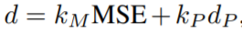
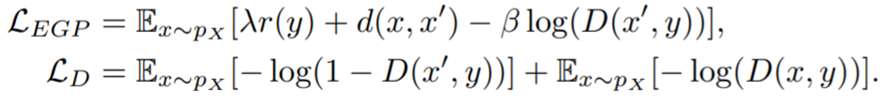
Loss function
1. We augment the neural image compression formulation with a conditional GAN, i.e., we merge equations mentioned above and learn networks E, G, P, D.
2. LPIPS:using a VGG-based loss
3. For a fixed λ, different kM, kP , β would thus result in models with different bitrates, making comparison hard. To alleviate this, we introduce a “rate target” hyper-parameter rt and replace λ with an adaptive term λ’, that uses the two hyper parameters λ(a), λ(b), where λ’ = λ(a) if r(y) > rt, and λ’= λ(b) otherwise.
Setting λ(a) >> λ(b) allows us to learn a model with an average bitrate close to rt.
(dp=LPIPS: perception distortion)

Slide 9
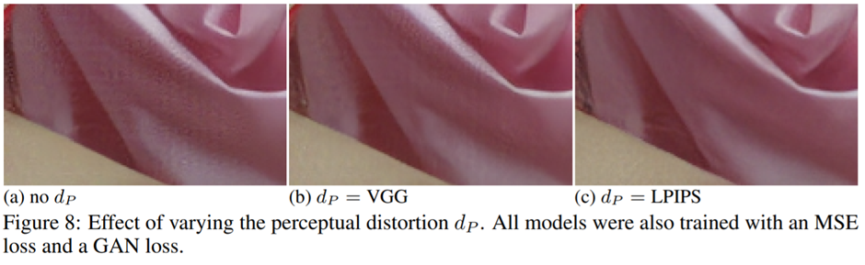
LPIPS
LPIPS measures the distance in the feature space of a deep neural network originally trained for image classification, but adapted for predicting the similarity of distorted patches, which is validated to predict human scores for these distortions.

Slide 10
More details-probability model P
1. For P, we use the hyper-prior model proposed in [6], where we extract
side information z to model the distribution of y and simulate quantization with uniform noise U(−1/2, 1/2) in the hyper-encoder and when estimating p(y|z).
2. However, when feeding y to G we use rounding instead of noise, which ensures that G sees the same quantization noise during training and inference.
[6] Johannes Ballé, David Minnen, Saurabh Singh, Sung Jin Hwang, and Nick Johnston. Variational image compression with a scale hyperprior. In International Conference on Learning Representations (ICLR),2018.

Slide 11
More details-discriminator D
1.we use a single-scale patch-discriminator D
2. we condition D on y by concatenating an upscaled version to the image.

Slide 12
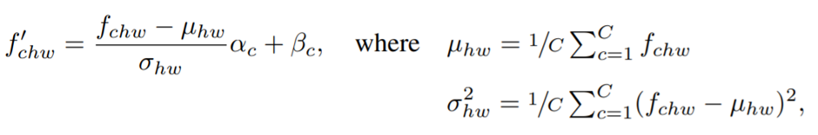
More details-Norm
Other model(instance norm):significant darkening artifacts when employing the model on images with a different resolution. We assume this is due to the spatial averaging of InstanceNorm.
Our model(channel norm):It normalizes over channels. The input is a batch of C×H×W dimensional feature maps fchw, which are normalized to
using learned per-channel offsets αc, βc.

Slide 13
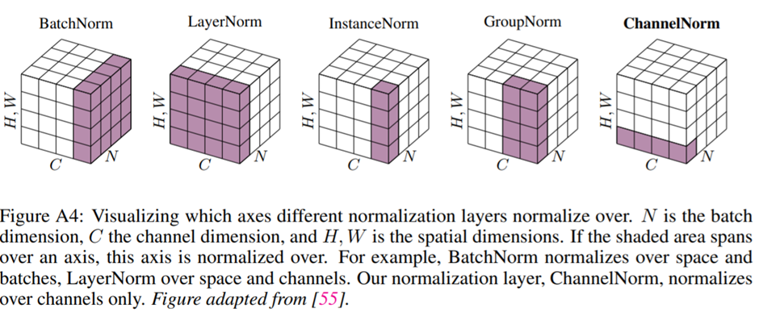
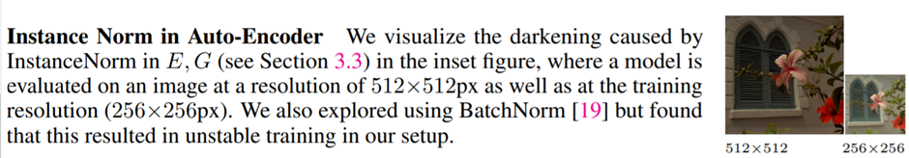

Slide 14
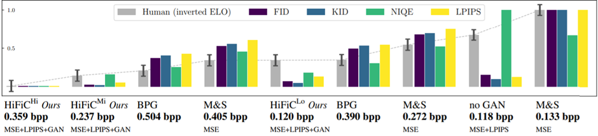
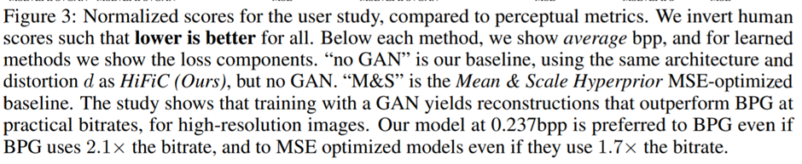
Experimental results
We use HiFiC models trained for rt ∈{0.14, 0.3, 0.45}, denoted HiFiCLo,HiFiCMi, HiFiCHi.
Bpp:bits per pixel

Slide 15
M&S is the deep-learning based Mean & Scale Hyperprior, from Minnen et al., optimized for mean squared error.
BPG is a non-learned codec based on H.265 that achieves very high PSNR.
No GAN is our baseline, using the same architecture and distortion as HiFiC, but no GAN.

Slide 16
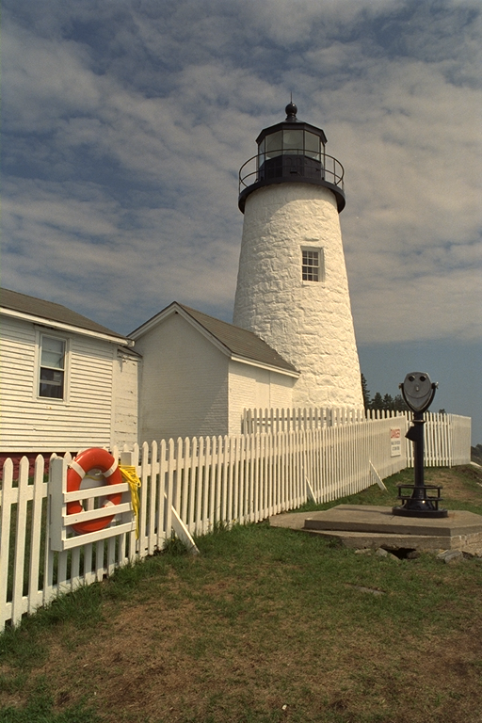
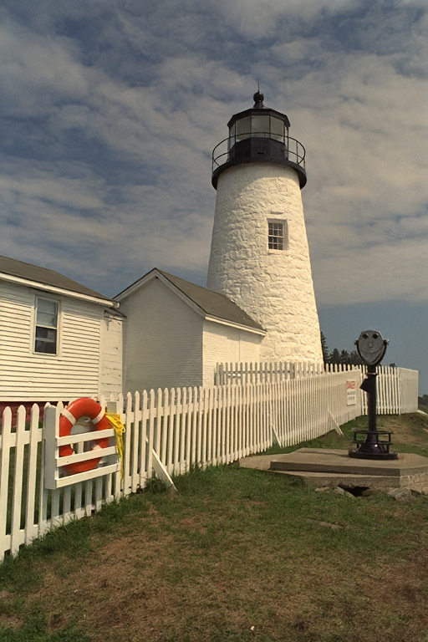
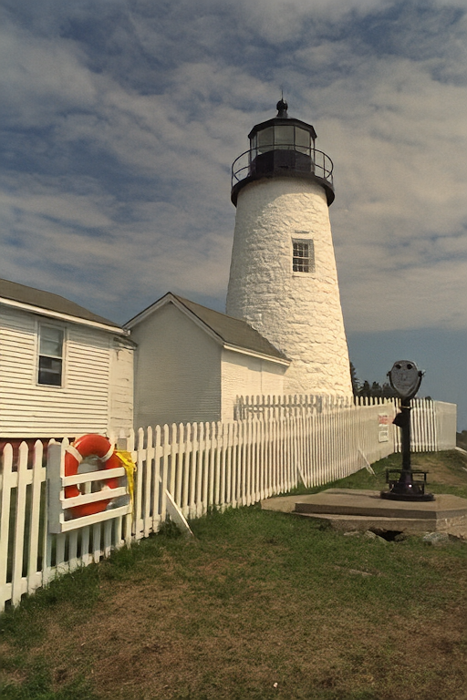
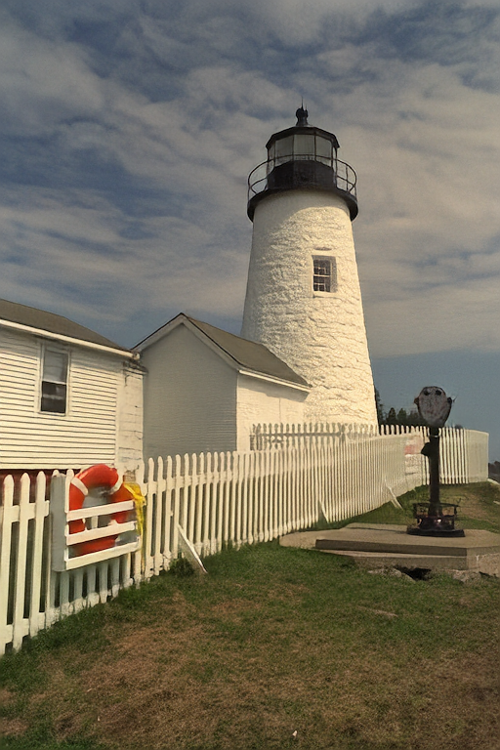
Experimental results
Original image
HiFiC Hi- bpp:0.503
HiFiC Mi-bpp:0.322
HiFiC Lo-bpp:0.162

Slide 17
Conclusion (optional)
In this paper, we showed how optimizing a neural compression scheme with a GAN yields reconstructions with high perceptual fidelity that are visually close to the input, and that are preferred to previous methods even when these approaches use more than double the bits. We evaluated our approach with a diverse set of metrics and interpreted the results with rate-distortion-perception theory.

Slide 18
Reference
1. https://arxiv.org/pdf/2006.09965.pdf
2. https://medium.com/ai-academy-taiwan/what-are-autoencoders-175b474d74d1
3. https://zhuanlan.zhihu.com/p/206470186
4. https://github.com/tensorflow/compression/tree/master/models/hific

